Slide 1
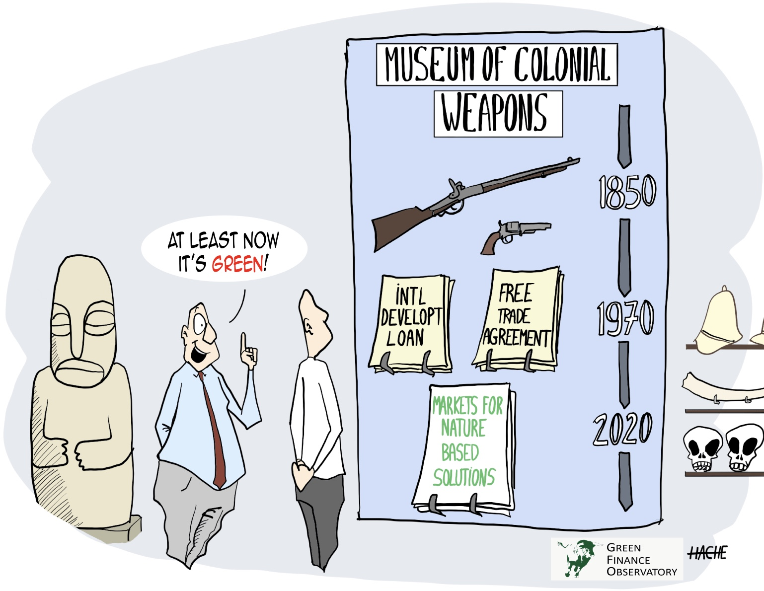
A Climate Counternarrative
Denis de Bernardy
ddebernardy@protonmail.com
//ddebernardy.substack.com
The Scientific Consensus is Wrong: It’s Soil, Not Oil

Slide 2
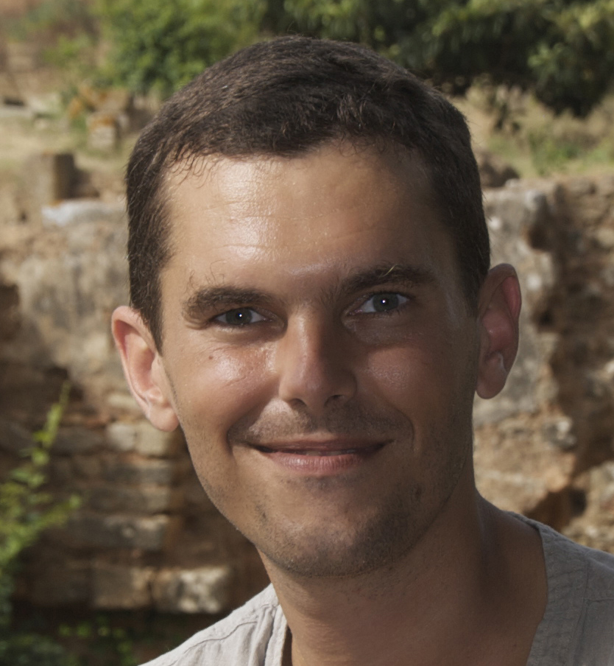
About the Author
A Disabused Environmentalist
Engineer
Permaculture
Agroecology
Soil Science
Publications
A Natural Language
A Climate Counternarrative

Slide 3
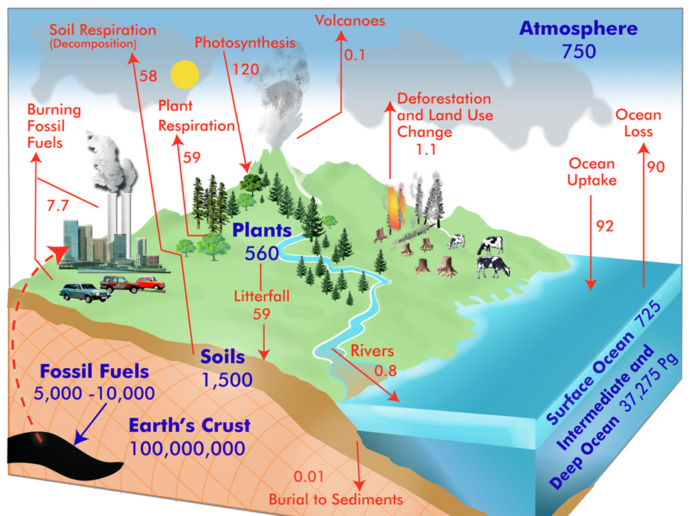
The Carbon Cycle
A Deeply Misleading Model
Industrial Activities: 7.7Gt
Land Use Change: 1.1Gt
Terrestrial Plants:
Plant Respiration: 59Gt
Soil Decomposition: 57Gt
Photosynthesis: 120Gt
Silences internal dynamics.
Source: GLOBE Carbon Cycle Project

Slide 4
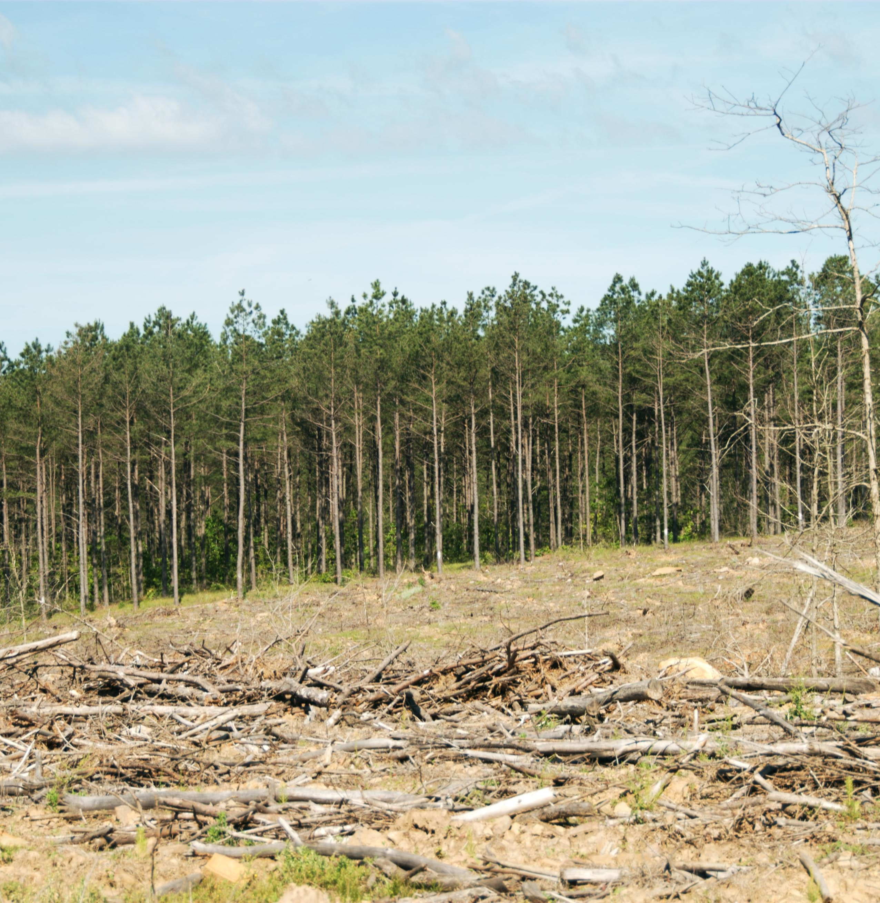
Forest Clear-Cuts
Trivially Avoidable Emissions
Plume of CO2 when you clear a forest (Korkiakoski et al, 2019).
Continues until the canopy is mature enough to soak it up.
No plume when you thin instead (Vesala et al, 2015).
Trees keep the fungi alive, break the wind, and soak up the CO2.

Slide 5
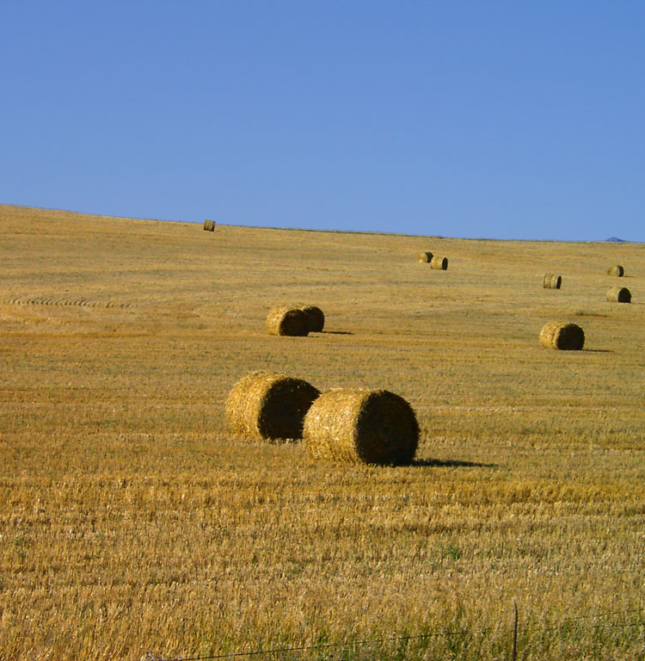
Canopy Loss
What Actually Changed
Forestry switched to clear-cuts.
Farm fields lost their hedgerows:
Fewer, larger landowners.
Factory farming.
Other emissions sources:
Midwest got settled.
Dead shallow waters?

Slide 6
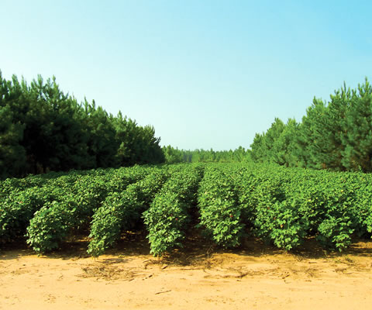
Simple Solutions
Put Plants Back In
Forest thinning.
Alley cropping.
Intercropping.
Sylvopasture.
Mob Grazing.
Can solve biodiversity as a bonus (see roadsides or “re-wilded” gardens).
Cotton growing in between pine alleys

Slide 7

Carbon Accounting
Designed By Financiers
Works like a financial statement.
Industrial emissions get tracked like expenses (flows).
Carbon stocks are like balance sheet entries (stocks).
Tracked as stock changes using long term models.
Keeps emissions out of sight.

Slide 8
This makes sense if and only if avoidable emissions hidden in stocks are negligible compared to those that appear as flows.

Slide 9
Logging Emissions
Anything But Negligible
A few kg of CO2 per square meter (Korkiakoski et al, 2019).
On the order of 10 tons per acre.
Loggers harvest over 60m acres per year. Most of that is cleared.
A German economy or so worth of trivially avoidable emissions.
Reduced-Impact Logging aims to reduce those (for carbon offsets).

Slide 10
You can tell when farmers are tilling, harvesting, or using fire to clear land.

Slide 11
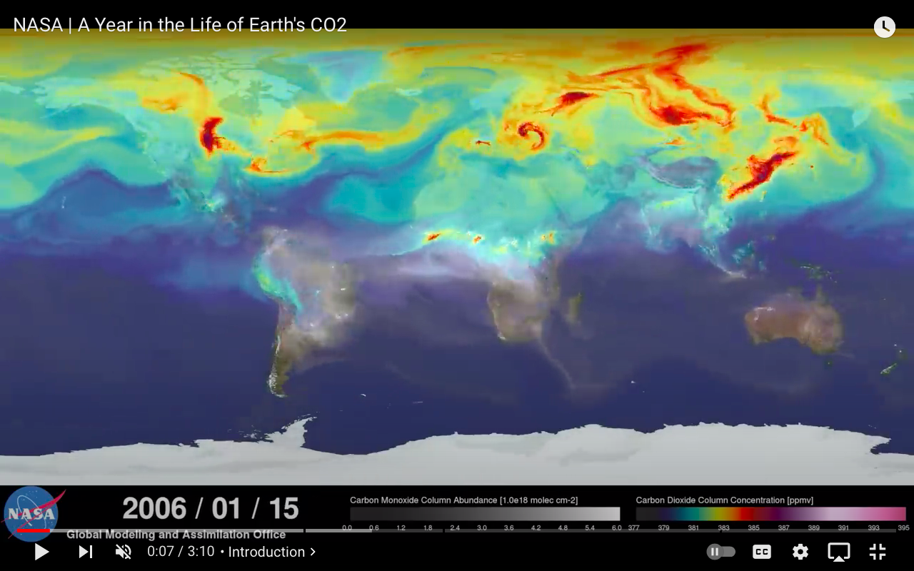
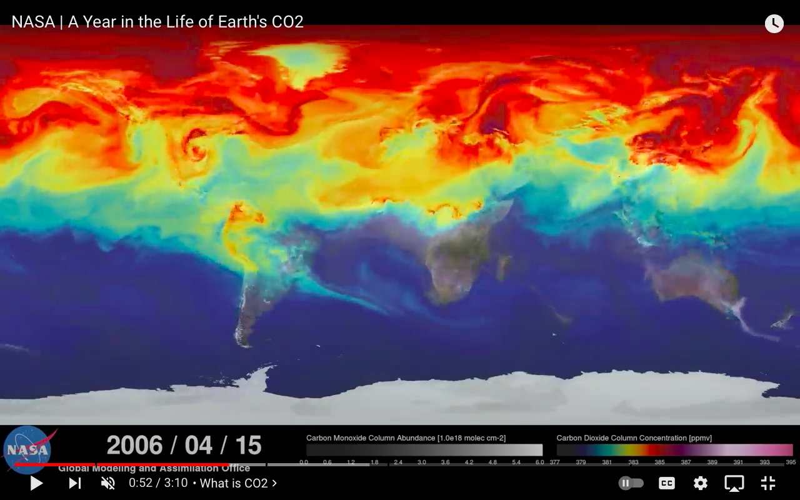
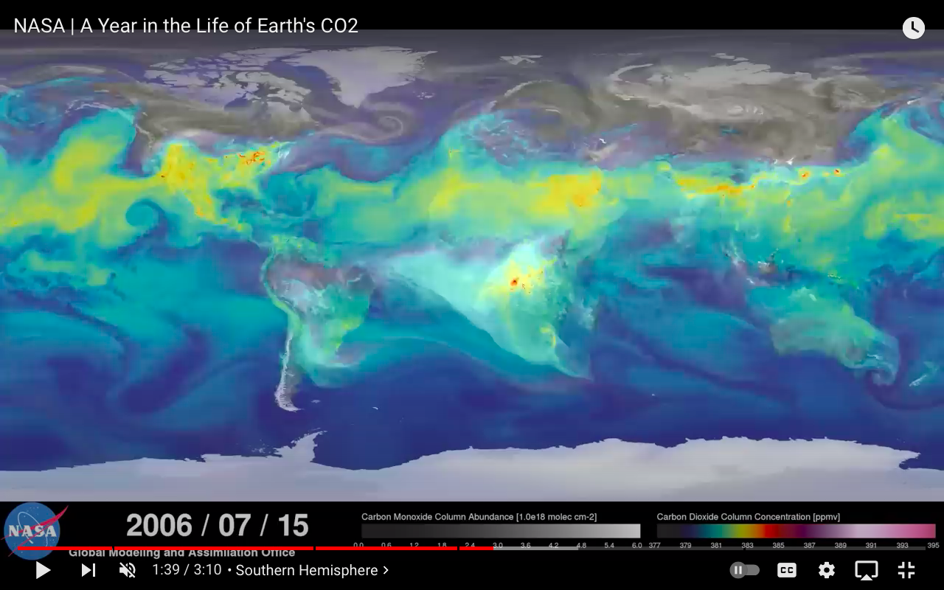
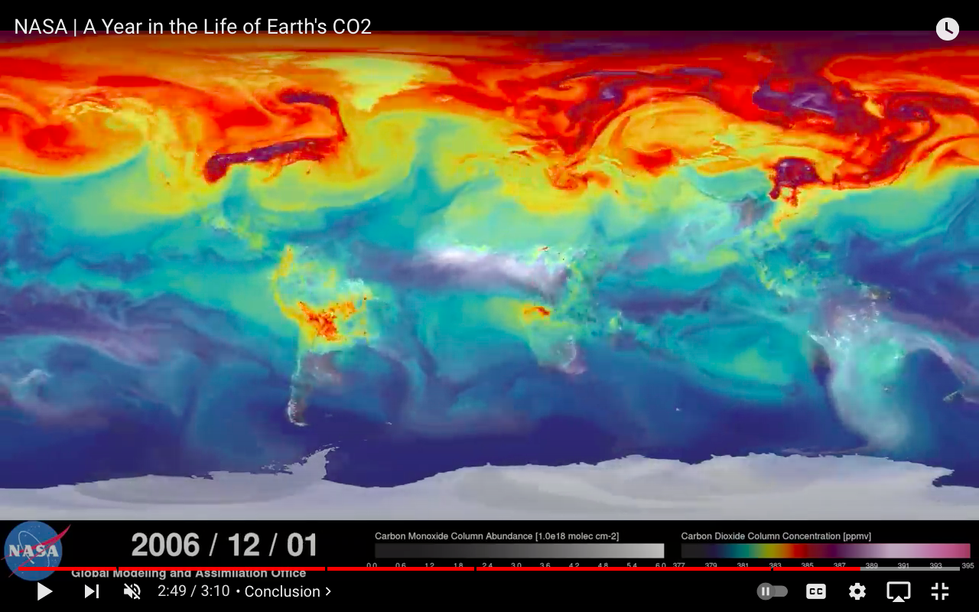

Slide 12
The Science is confusing a canopy loss problem for an energy problem.

Slide 13
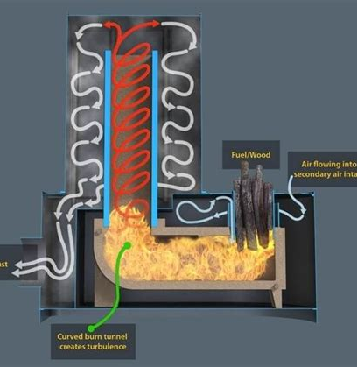
Fossil Fuels
Beneficial Plant Food
12% of atmospheric CO2 (Skrable et al, 2022).
Likely comes from sources with no nearby plants, like industrial smokestacks or airplanes.
Rocket mass heater and drip irrigation like setups could be used to bio-sequester it.
Or just leave it up there.
A rocket mass heater

Slide 14
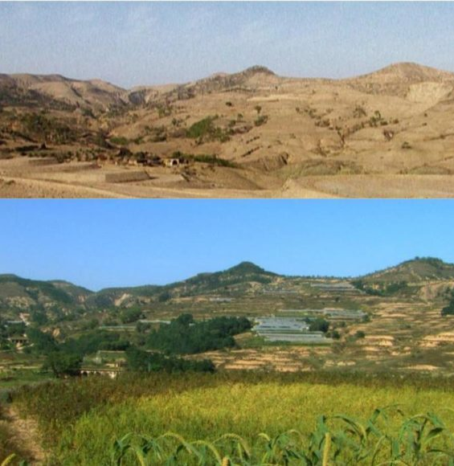
Disputable Science
Man-Made Desertification
Soil with less carbon and less cover retains less water.
Topsoil loss is desertification.
Compounded by plantations.
Desertification is reversible.
Slow down water and wind.
Biodiversity loss, floods, and fires are largely man-made.
Loess Plateau, before and after restoration

Slide 15
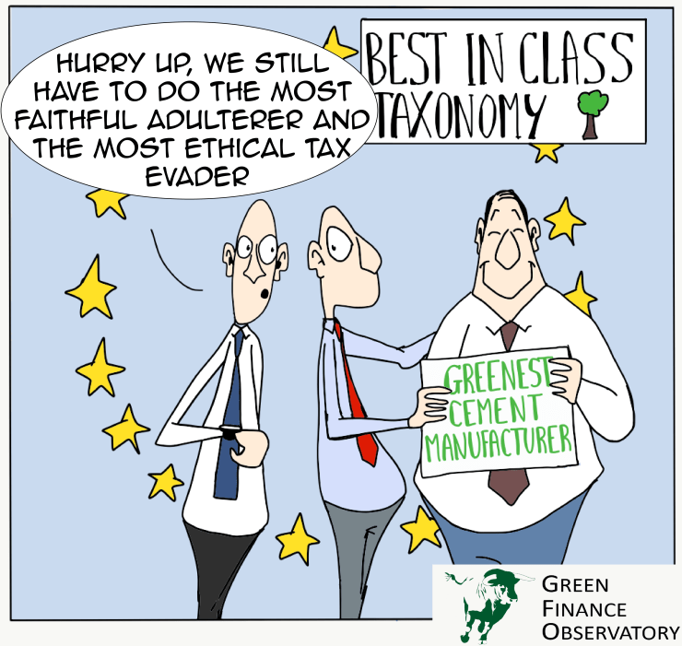
Shameless Fraud
A Carbon Accounting Chicanery
Carbon “income” sources:
Carbon allowances.
Carbon credits (indulgences).
Green tech.
Carbon offsets:
Subsidies (plantations, mines).
Land grabs (conservancies).

Slide 16

Control Agenda
A Green New World
Programmable money (CBDCs).
Monitoring (ESGs, 15-min cities).
Tithes (nature-based solutions).
Land grabs (30x30 plan, mines).
Inverted values (reparations).
Depopulation (jabs, famines).
New Age religion.

Slide 17
Conservancies are tax exempt, will collect a green tithe, and will be exempt from wealth clawbacks. Their elite beneficiaries will have the last laugh.

Slide 18
Exploring Further
Revisiting the Climate Narrative (short article): https://eartharxiv.org/repository/view/5246/
A Climate Counternarrative (extended article): https://ddebernardy.substack.com/p/a-climate-counternarrative
A Natural Language (book): https://ddebernardy.substack.com/p/a-natural-language
A Natural Language (SubStack): https://ddebernardy.substack.com

Slide 19
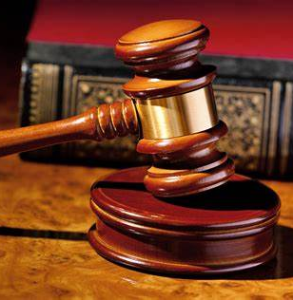
Next Steps
Let’s Work Together
Litigating the attribution science could thwart the agenda, so it is very risky for the conspirators.
Potential angles of attack:
Need for carbon offsets.
Need for conservation.
Motives of conservancies.
Soundness of the laws.

